Slide 1
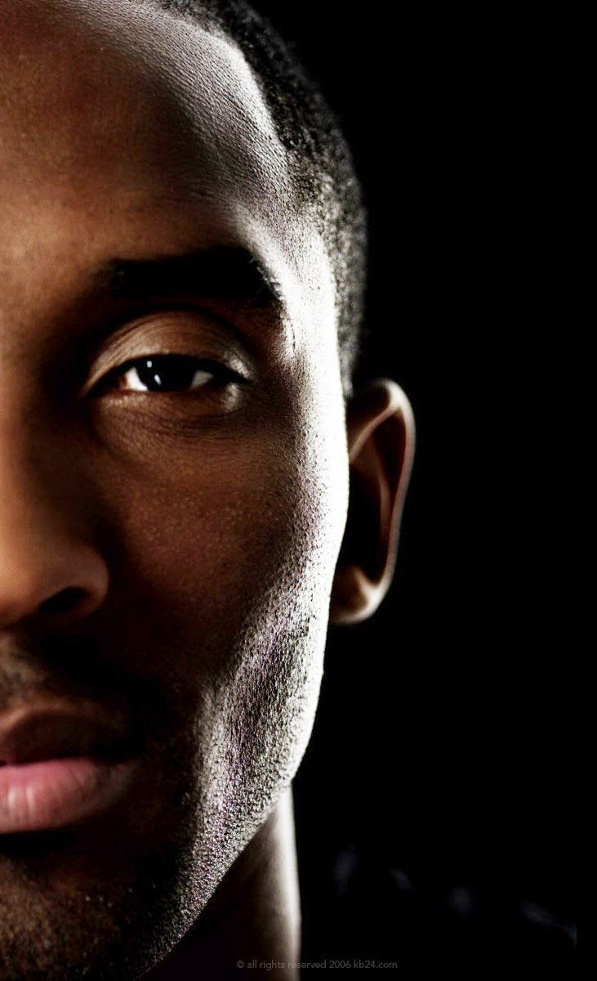

Black Mamba Prediction
Application of Binomial Linear Regression to predict field goal outcome from Kobe Bryant
Presented by Hannah Kosinovsky, Yat Leung, and Javier Saldaña

Slide 2

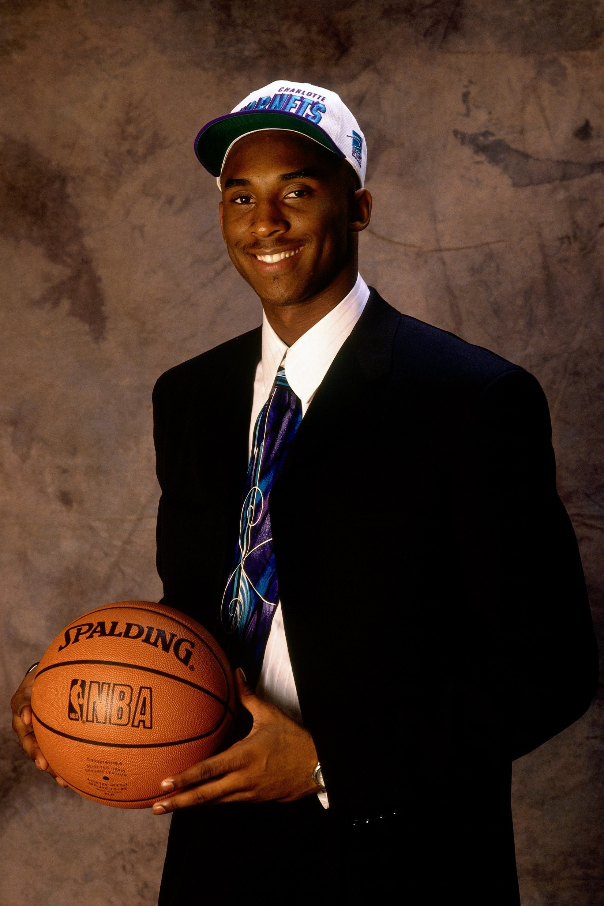

KOBE “BLACK MAMBA” BRYANT
Drafted by Charlotte Hornets in the NBA Draft of 1996
Youngest point guard ever drafted
Career from 1996 – 2016 (Los Angeles Lakers)
Accolades
10X All-NBA 1st Team
All-Defensive 2nd Team (2012)
7X All-Defensive 1st Team
3X All-Star MVP (2011, 2009, 2007)
2X Finals MVP (2010, 2009)
MVP (2008)
All-NBA 3rd Team (2005)
Source: http://www.espn.com/nba/player/bio/_/id/110/kobe-bryant

Slide 3

The Data Set

Slide 4
The Variables
recID | Action_type | Combined_shot_type | Game_event_id | Game_id
lat | Loc_x | Loc_y | lon | Minutes_remaining
period | playoffs | season | Seconds_remaining | Shot_distance
Shot_made_flag | Shot_type | Shot_zone_area | Shot_zone_basic | Shot_zone_range
Team_id | Team_name | game_date | matchup | opponent
Shot_id | attendance | arenatemp | avgnoisedb

Slide 5
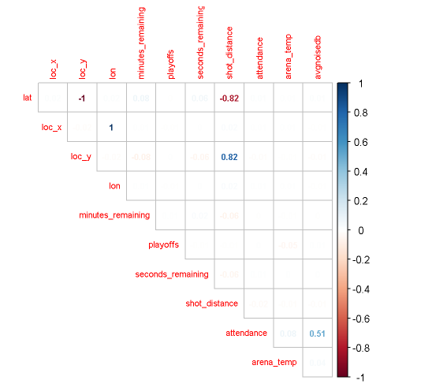
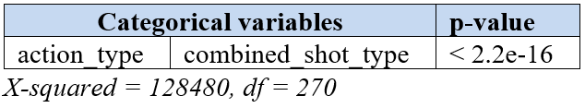
Multicollinearity & Independence
Lat → loc_y & shot_distance
Lon → loc_x & shot_distance
action_type & combined_shot_type

Slide 6
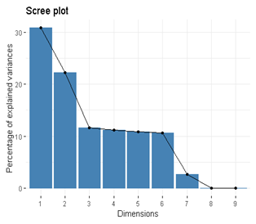
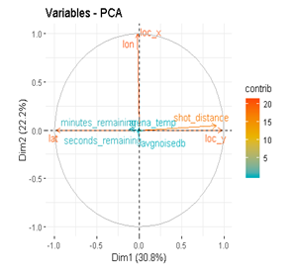
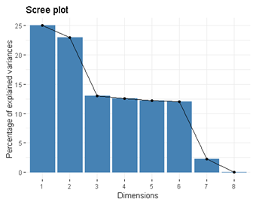
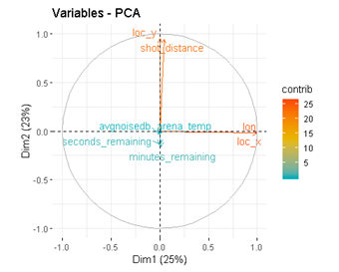
Multicollinearity & Independence
52% of variance explained w/ lat
48% of variance explained w/o lat

Slide 7
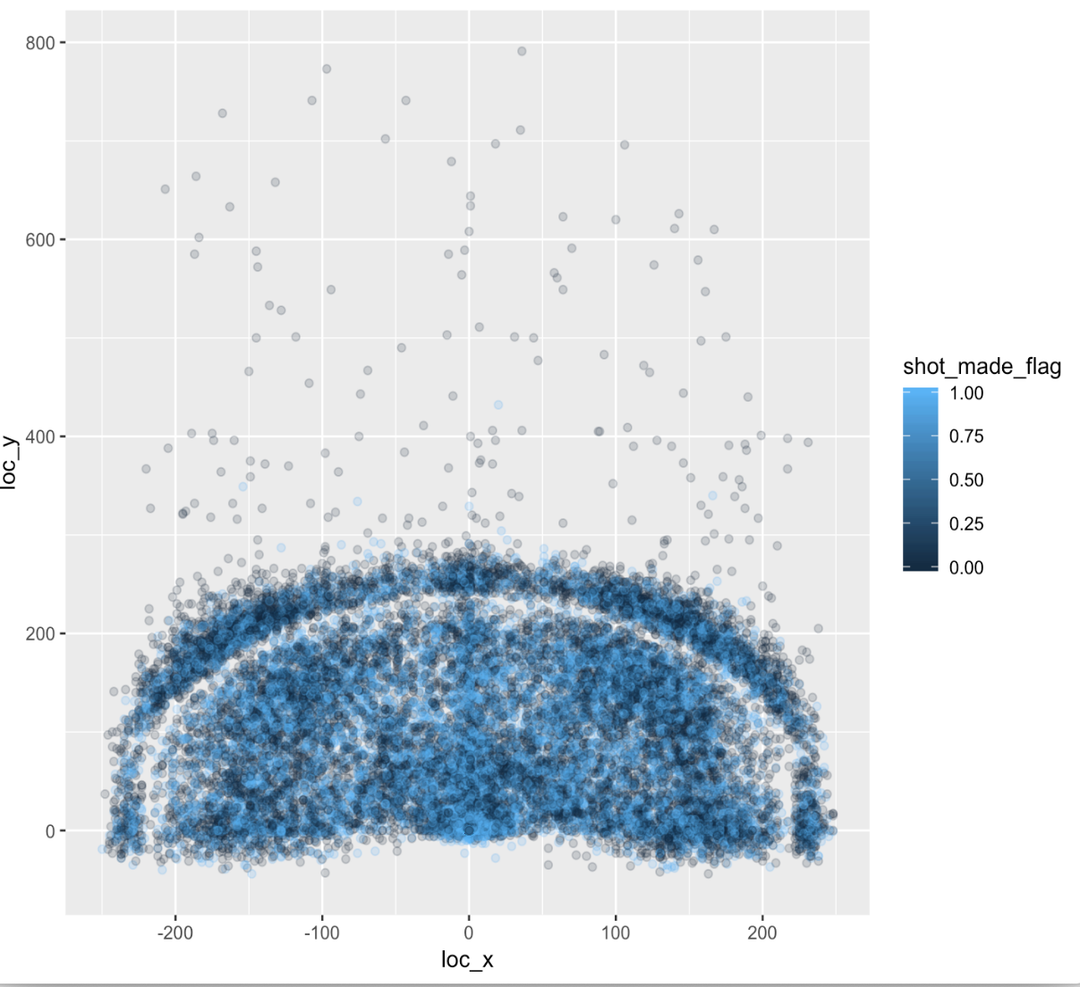
Field Goals v. Distance
Central Limit Theorem
Location clusters
ggplot(data = Kobe)+geom_point(aes(x = loc_x, y = loc_y, color = shot_made_flag),alpha = 1 / 5)

Slide 8

The Questions of Interest

Slide 9

Questions of Interest
Odds of making the shot as distance changes
Probability of making the shot as distance changes
Relationship between distance and odds of making the shot in the playoffs
Predictive model of a successful field goal

Slide 10
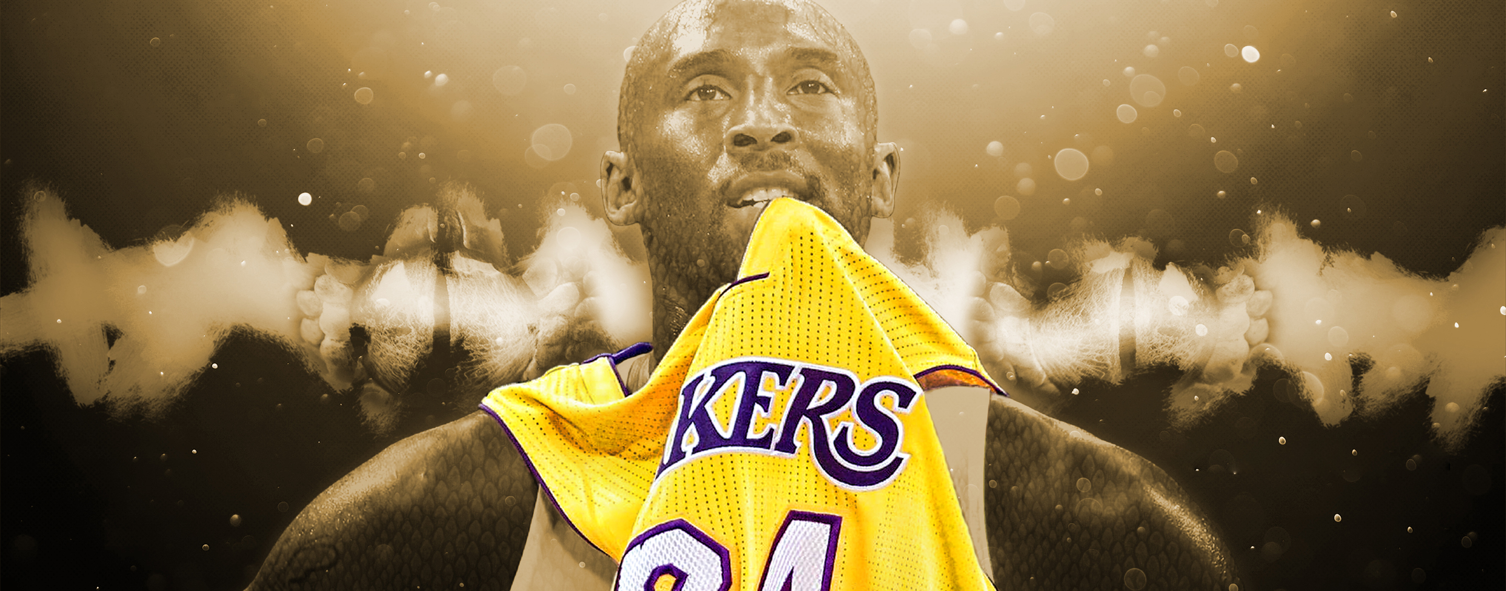
The Models

Slide 11
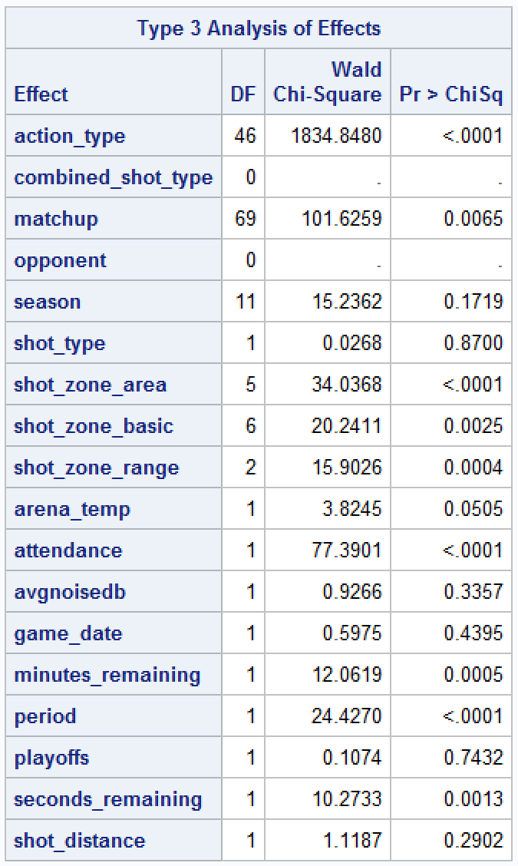
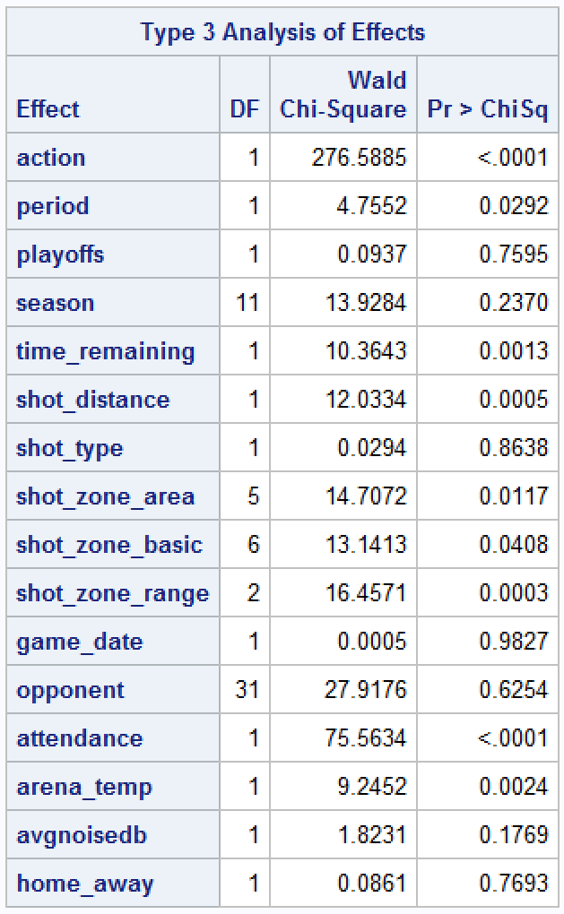
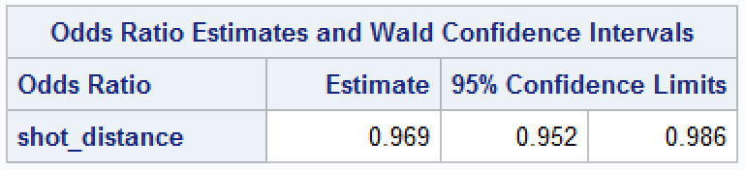
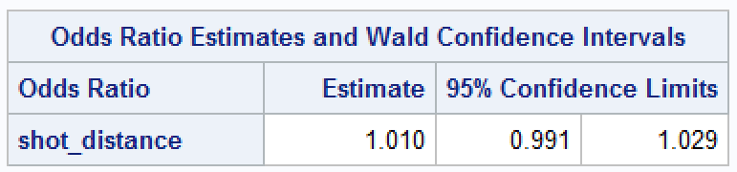
Distance v. Odds of Successful Field Goals
Full model v. Reduced model
Full model
Odds ratio = 1.010
Not significant
Reduced model
Odds ratio = 0.969
Significant

Slide 12
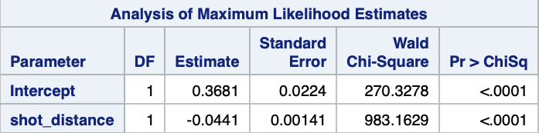
Distance v. Probability of Successful Field Goals
Negative slope for shot_distance
Significant shot_distance

Slide 13
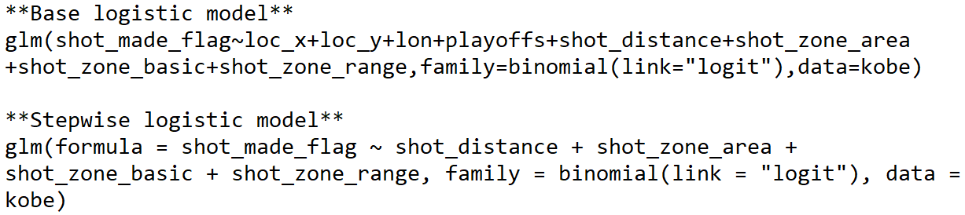
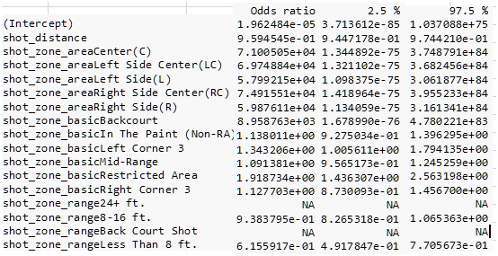
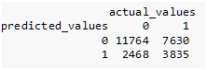
Field Goals in Playoffs & Predictions
Odds Ratio in Playoffs
Odds increased in “8 – 16 ft” and “8 ft or less”
Stepwise
Playoffs removed
Not significant
Confusion Matrix

Slide 14
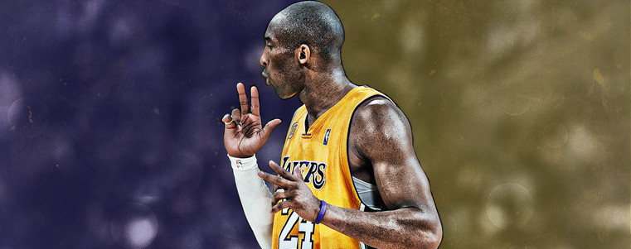
The Conclusions & Inferences

Slide 15
Results
Conclusion
Inferences & Future Studies
Odds ratio increases slightly w/ distance
Probability decreases w/ distance
Playoffs don’t have a significant effect on odds ratio of field goal
Results only applicable to Kobe
Kobe played within his skill level
Broaden scope to all NBA players

Slide 16

The End
Hannah Kosinovsky
Yat Leung
Javier Saldaña

